Slide 1
Handheld Gamer
Weiming Xu

Slide 2
Problem area
I will use an Arduino Nano with an 8x8 LED matrix to make a handheld game. I plan to create a Sokoban type puzzle game based on Patrick’s Parabox.
Objective list
I will use an 8x8 LED matrix as a screen to draw the game on.
I will create a playable character, which can be moved using 4 buttons.
I will create walls, which will stop the player.
I will create boxes, which can be pushed by the player.
I will create goals, which the boxes should be pushed onto.
I will create levels, which can be completed, when the boxes reach the goals.
I will create a menu, which the player can navigate and select a level
I will allow the player to exit to the menu, to stop situations where the player would get permanently stuck.
I will add recursive boxes.
I will create multiple levels, with a range of difficulties, to display and teach mechanics to the player.

Slide 3
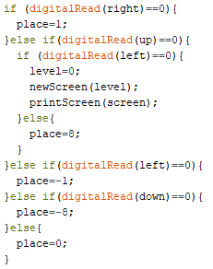
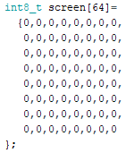
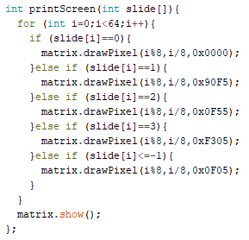
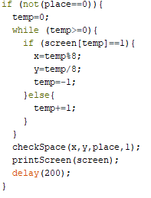
Drawing the screen
I am going to use an array to store the screen. It will contain 64 numbers, to represent different possible states, for example, 0 will represent a blank space. It will list the index the pixels from 0-63, with 0 being the top left corner of the screen and 63 being the bottom right corner.
Creating the player
The program will wait for an input, and then read it. The 4 buttons will each correspond to a different cardinal direction.
This checks for the different buttons, and sets the place variable to the change in position on the screen.
When the bottom two buttons are pressed, it sets the level to 0, which will return to the main menu.
The array will then be passed through a function to draw the pixels.
This will find the x and y coordinate of the player and then pass it into a function, checkSpace.
Objective 1
Objective 2

Slide 4
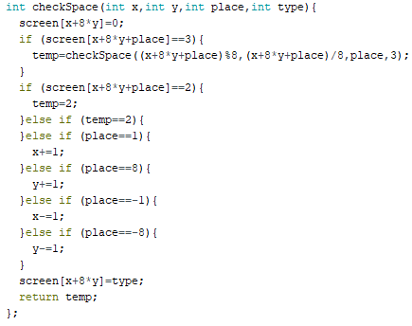
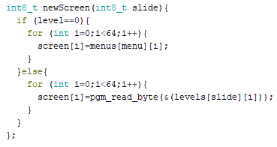
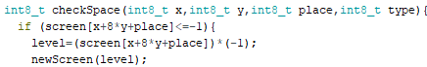
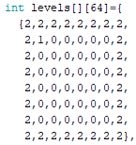
Collision with walls and push able boxes
I am going to create a function to check the space in the direction of movement, for what object is there.
Creating menus and levels
First I will need to create an array to store the menus and levels. Using this I will then need to create a function to allow the screen to change.
This checks for whether the level=0 (in which case the menu should be shown), otherwise it will set screen to that level.
In order to enter levels I will need to change the checkSpace function to first check for a level first, before continuing like normal.
This takes four inputs, the x and y coordinate, the direction of movement(place=1 is right, etc.) and the type of the object moving(player or box).
It will first clear the current position.
Then it checks if it is a box in the next position. In the case that it is it will call the function with the box as the moving object.
It then checks for a wall, if it is a wall, it sets temp to 2, which will be returned.
If temp is 2, nothing will move.
Otherwise it will change the x and y coordinate depending on the direction moved and sets that pixel to the object type.
This can then later be printed after all movement is done.
This works by storing levels as integers less than 0. This will allow me to quickly check whether it is a level, and quickly convert to the level number, as no other items will need to be stored as a negative number.
The function checks for if it is a level.
Then it sets the level variable to the absolute value of it.
An example of a level, stored as a 2-dimensional array, the first number indicating the level number, the second one indicating the position of the pixel in the level
Each level is formatted as an 8x8 grid to make it easier to read, but is just a list of numbers
Objective 3, 4
Objective 6, 7

Slide 5
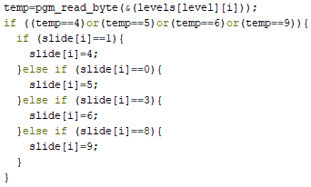
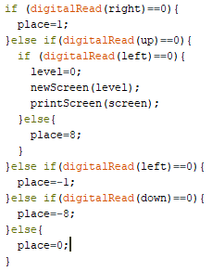
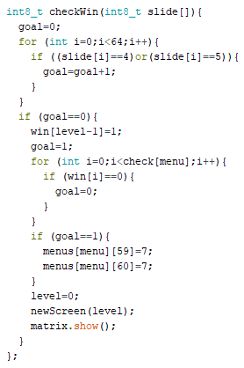
Goals for the boxes
I am going to need to add values to show the goals. Then I will need to add a check to ensure that the goals will remain after having a box or player go over them. This will also check for how many goals are not covered by a box. This will allow me to check for when the level is complete.
Quitting to the menu
To stop the player getting permanently stuck, I will edit the reading of inputs to check if the bottom 2 buttons are being pressed at the same time.
This is added to the newScreen function, that adds a visual change to show that the player or a box is on a goal
This also ensures that when an object is removed from the goal that the goal remains
This checks through all the pixels and checks for when there is a goal without a box on it.
Objective 5
Instead of moving it sets the level to 0 (which indicates that it is currently in the menu), then it uses the newScreen and printScreen function to change the screen back to the menu.
Memory problems
Since I have been storing the levels as constants, they have been taking up a lot of memory, since each level has 64 pixels, which are each 2 bytes. The Arduino nano has only got 2kB of RAM. To fix this problem, I changed all the variables to only using 8 bit integers, which is the smallest inbuilt data type.
This checks for whether all the levels currently accessible are complete.
If they are it unlocks the next menu and levels
Objective 8

Slide 6
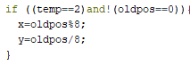
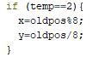
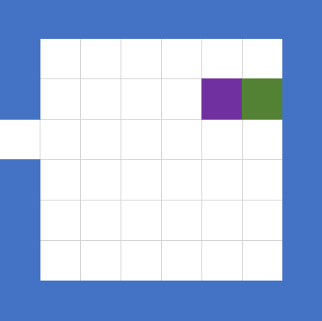
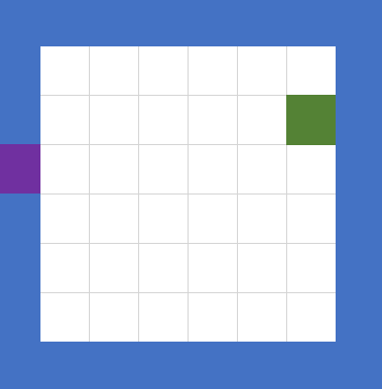
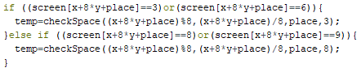
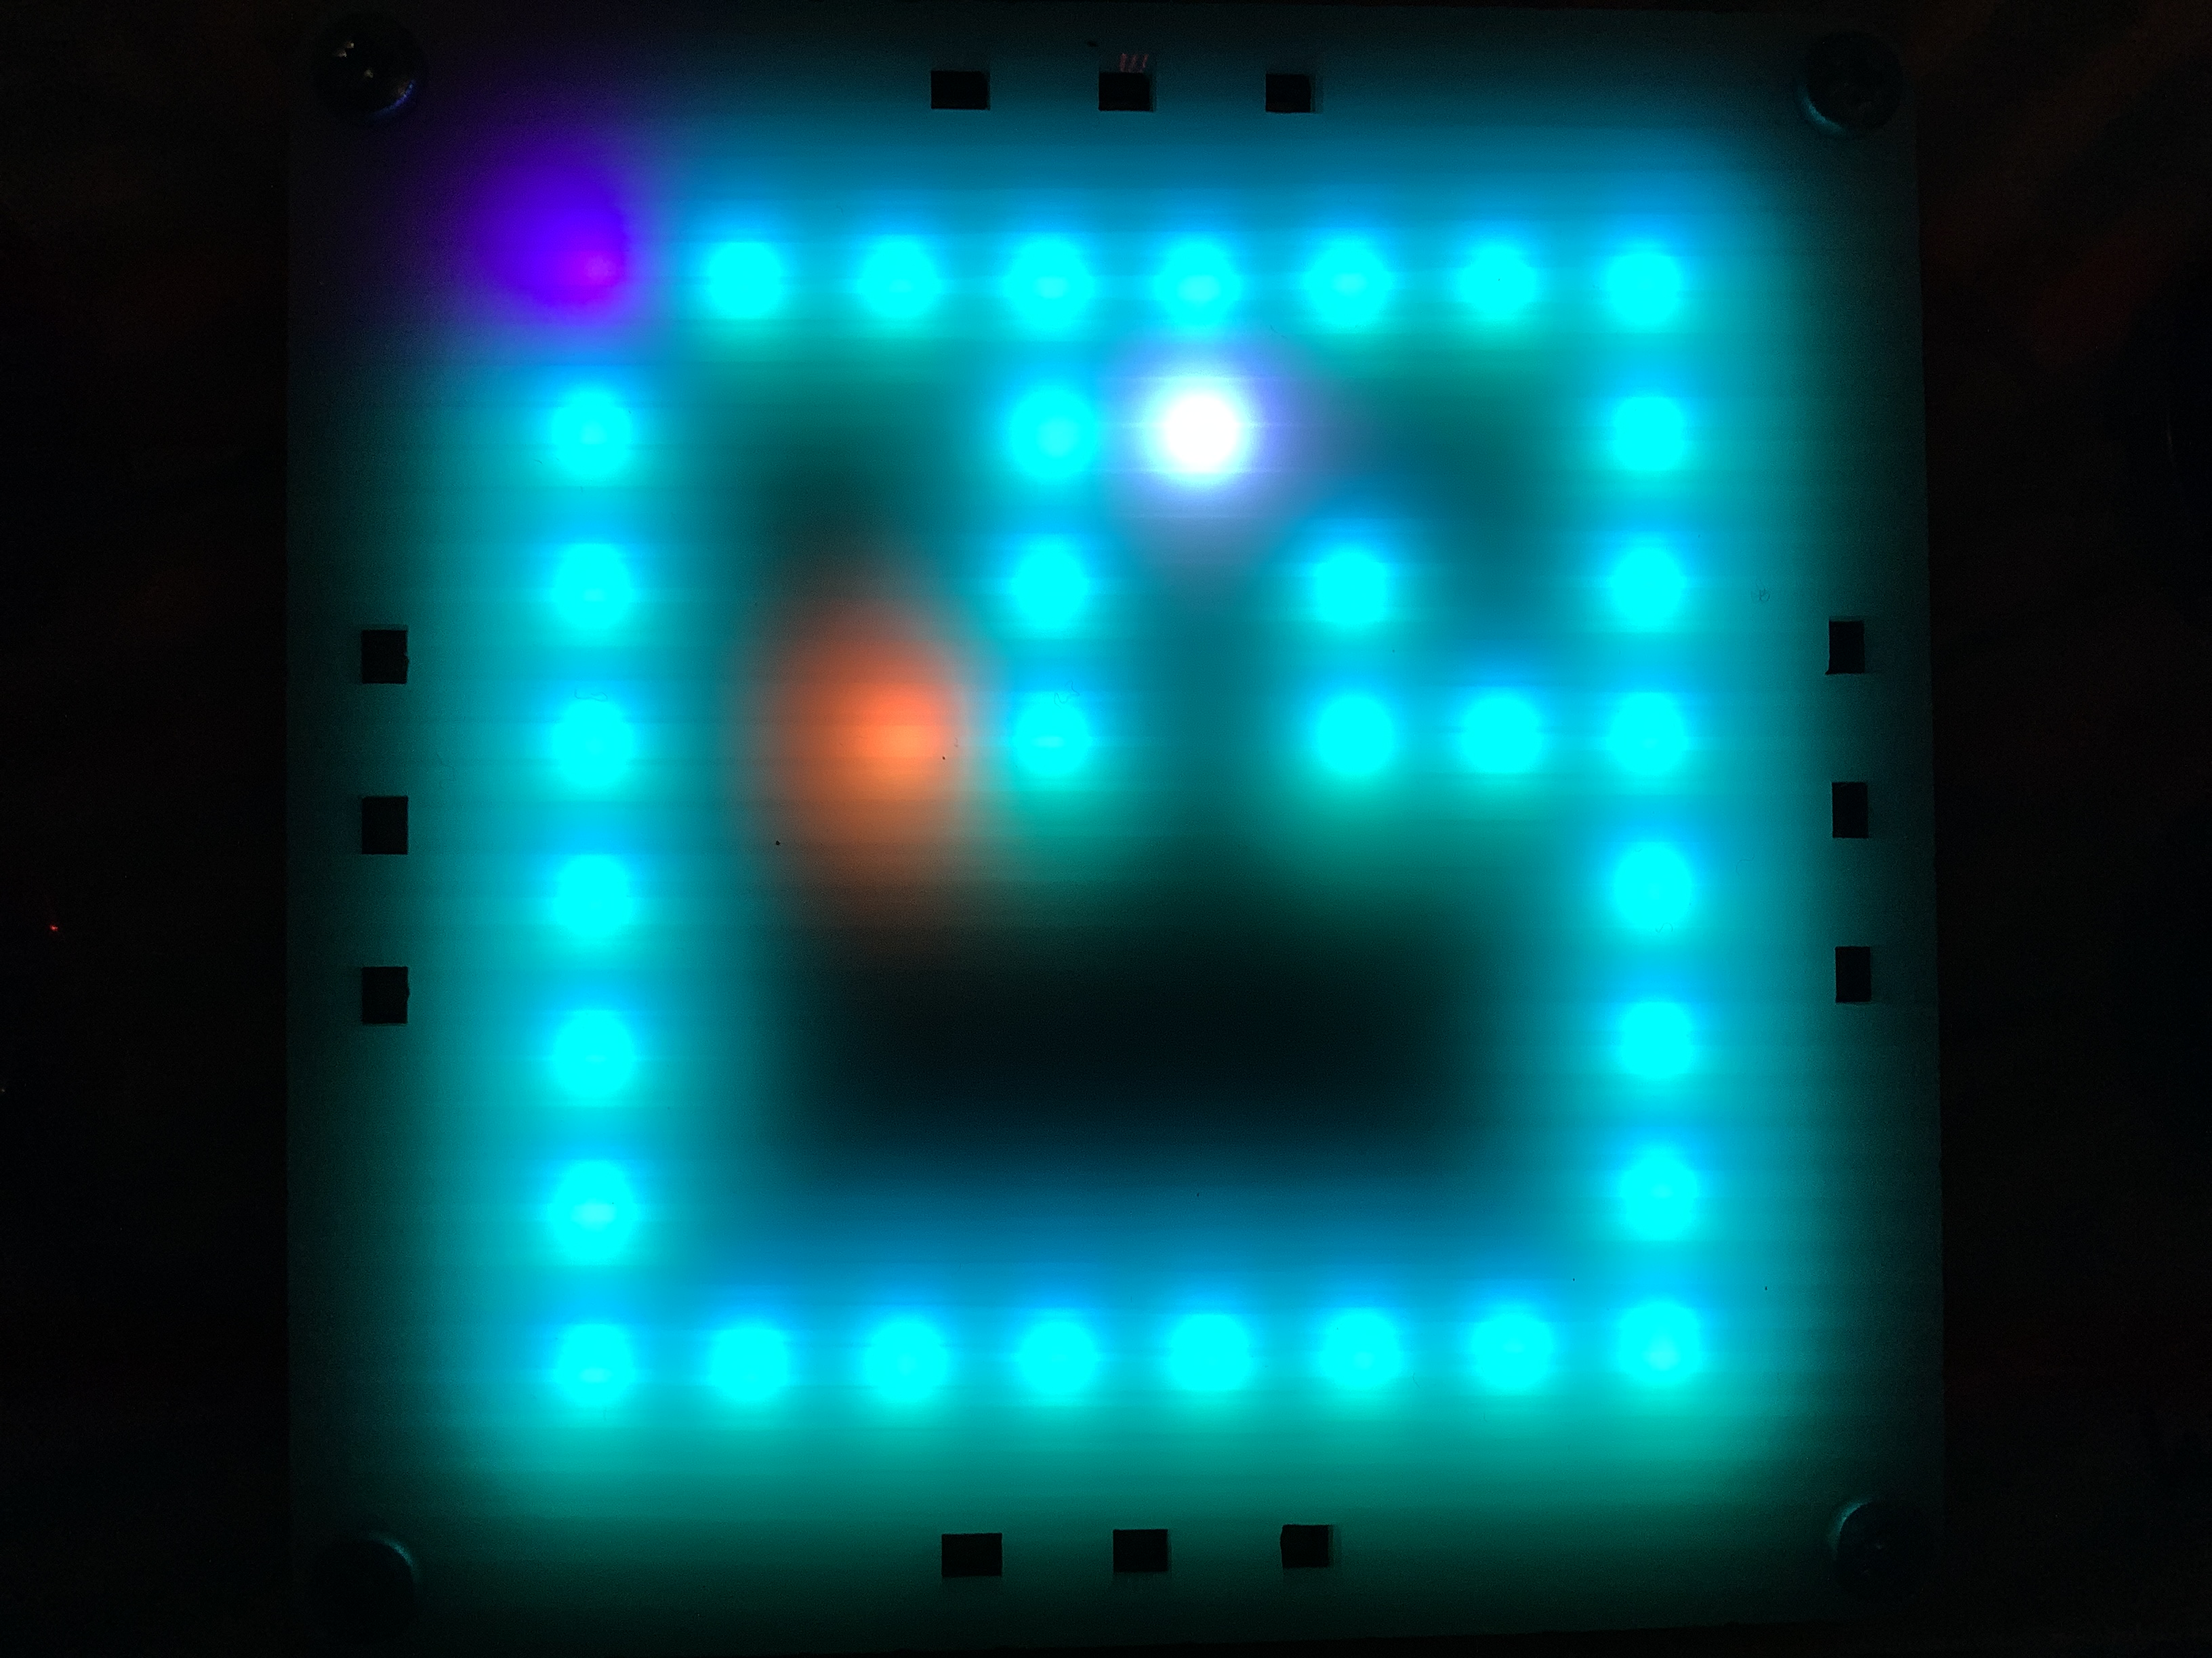
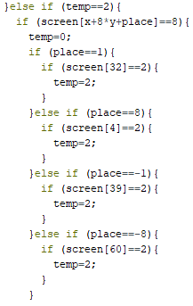
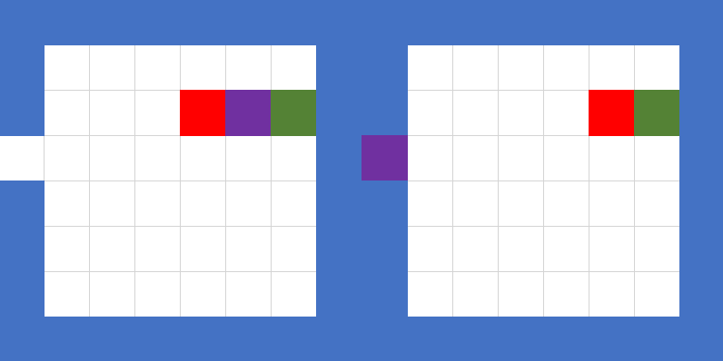
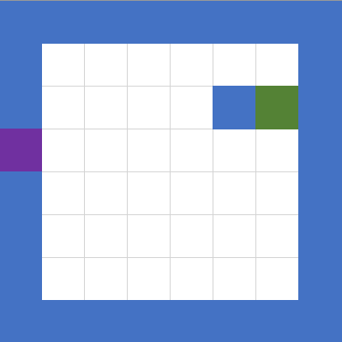
To stop this, I changed the code to this, and added a line, which set the old position to 0 before calling the function. This will work, since there is no possible time when the oldpos should be at 0
Recursion
I will add a box that will allow the player and boxes to enter or exit them. The player will then be at the entrance or exit to the level.
To stop the player overwriting the level box, when there isn’t space next to it, I added this line here.
Right movement
This adds collision to the level box to allow it to be pushed around
By moving right into the green level box, the player ends up at the left side of the level
Conversely moving left at the left side will send the player to the spot directly left of the level box. This will push any boxes in the way, and will not be able to happen if a wall is in the way.
This then checks to see if the level box is being pushed against a wall Then depending on the direction of movement, checks whether there is space for the player or a box to go
This was because by default oldpos was set to 0, so instead of using this when there wasn’t space for the player to leave, it would use this whenever the player collided with anything.
Left movement
Left movement
However, this ended up causing a bug, where the player would end up in the top left corner, whenever pushing against a box.
Purple-Player, Blue-Wall, Red-Box, Green-Level box

Slide 7
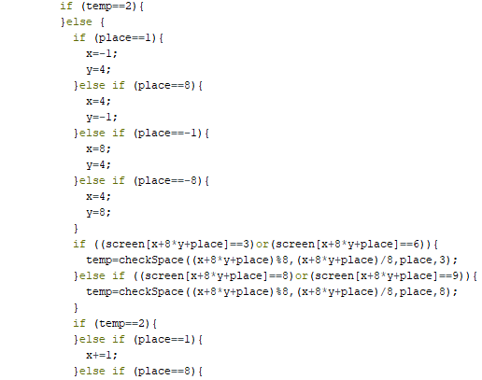
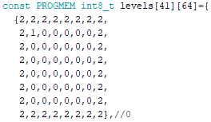
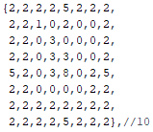
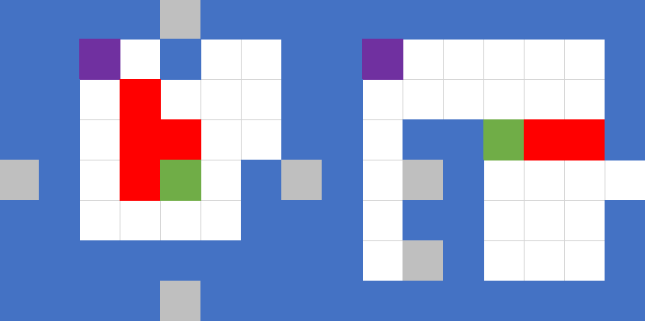
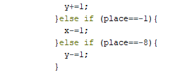
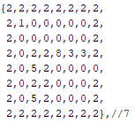
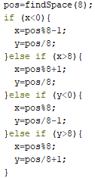
Making more levels
This then sets the new coordinates for the object to go to.
Further memory problems When I was making more levels, I encountered this problem again. This time I stored the levels in the program memory, since there was 30kB of that and the levels could be constants and wouldn’t need to change. In order to do this, I had to change how the program references the array. This reduced the dynamic memory usage from 86% to 30%.
If the position is a negative, this means that there wasn’t space for the object, so the object is put back to where it was before movement
This then calls the function again to check the next spaces
If there isn’t space the x and y coordinates won’t change
Some example levels
I also changed the level boxes to always enter with a bias to the bottom right, since there is no exact middle pixel out of 8.
Labelling the columns and rows from the top left starting at 1, makes the entrances at column or row 5
Objective 9
Objective 10

Slide 8
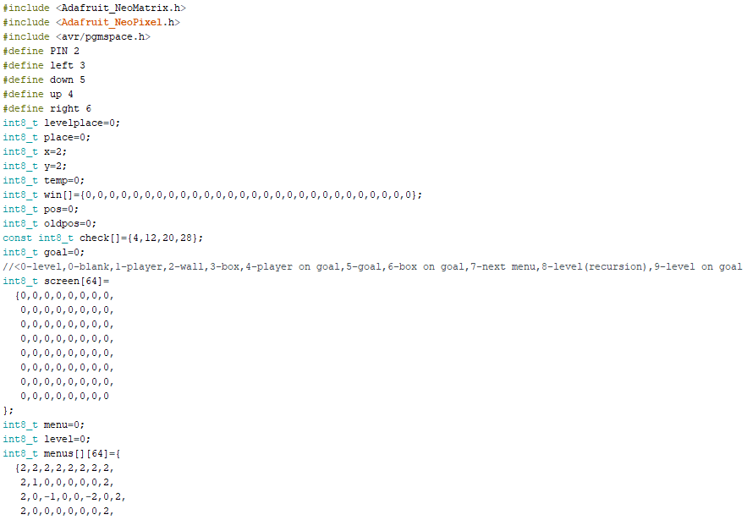
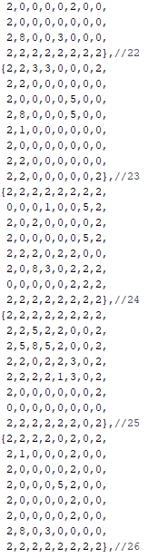
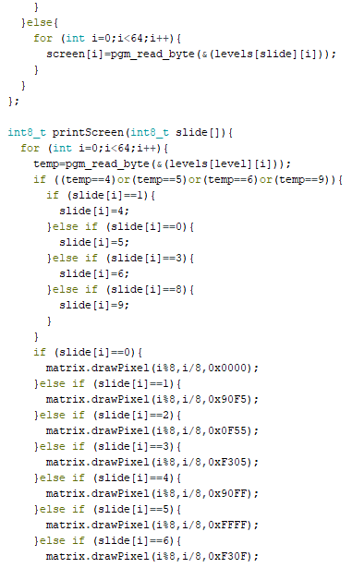
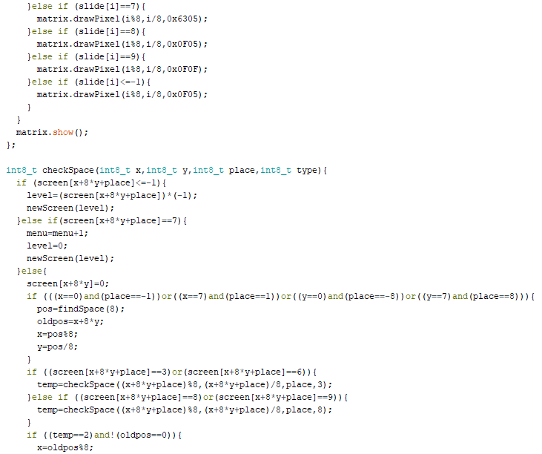
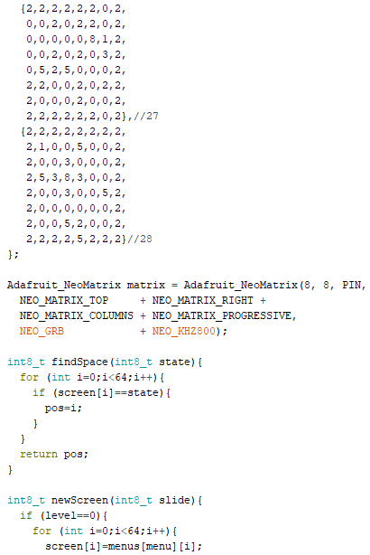
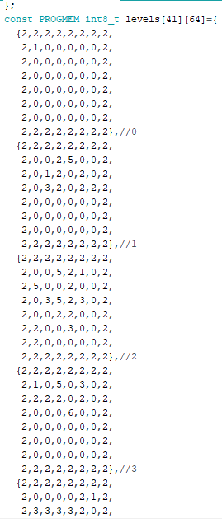
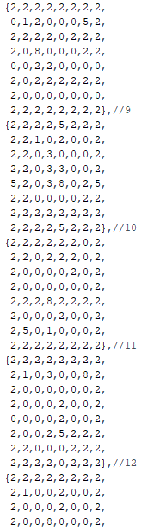
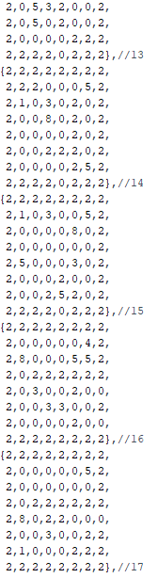
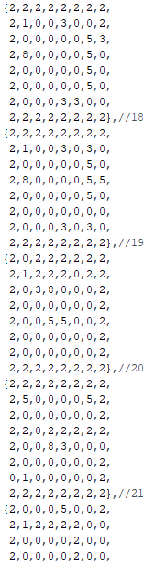
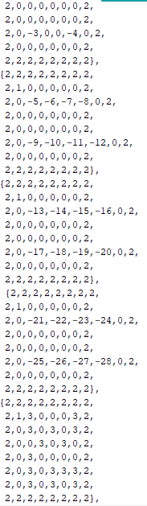
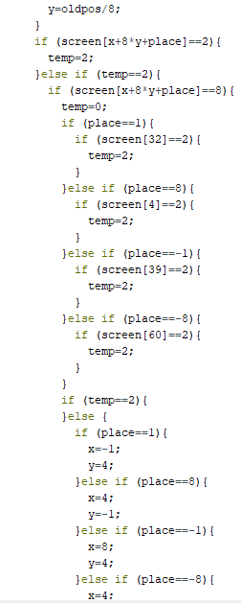
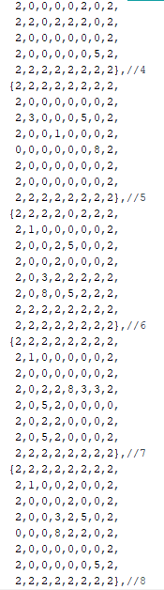

Slide 9
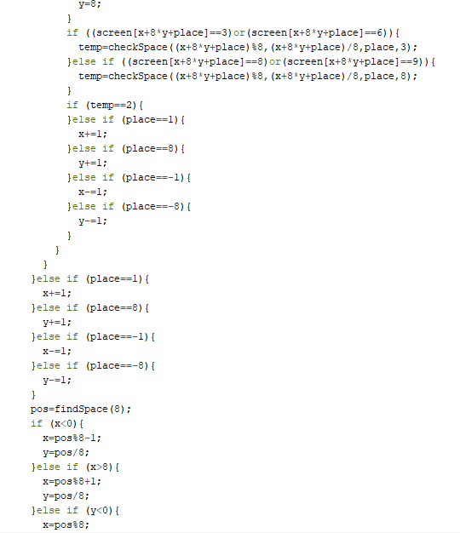
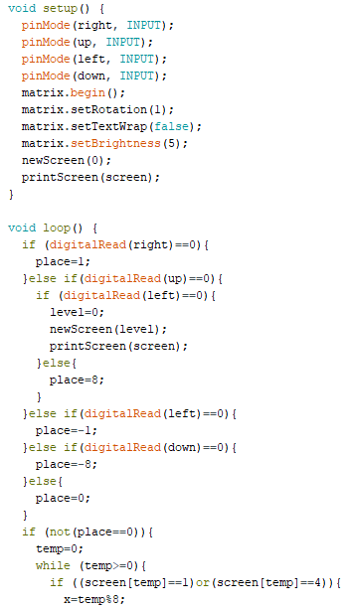
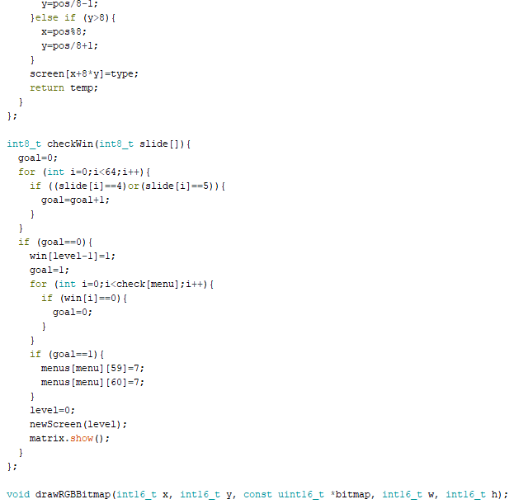
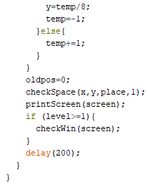
Evaluation
With this project, I think that overall it went well. Since I was able to hit all the objectives, and I think the game managed to reach a suitable level of complexity.
If I continued to work on this, I would like to try new mechanics, such as multiple level boxes in a level, non-recursive boxes that can be entered.
If I were to redo the project, I would like to use different hardware, as the Arduino nano had limited memory and the 8x8 LED matrix limited the scale and detail in the game. I could also try to use object oriented programming instead of using functions.

